Slide 1
IBM Cloud Private Architecture

Slide 2
IBM Cloud Private Major Components
Topologies
Nodes
Services
IBM Cloud Private Architecture
Components
Interfaces
Services

Slide 3
IBM Cloud Private Architecture
Major Components

Slide 4
Topologies
The ICP Kubernetes cluster consists of both mandatory and optional components. Consider the following typical topologies:
Simple
Single machine install with the master node performing worker node duties
Works well for learning the platform and testing basic workloads
Standard
1 master, 1 proxy, 1 management, 3 workers and optionally a Vulnerability Advisor node
Great for non-production workloads and testing
High Availability (Enterprise)
3 or 5 masters, 10+ worker nodes, 3 proxies, 2+ management nodes, 1 or 3 Vulnerability Advisors
Ideal for production and enterprise deployments

Slide 5
Boot Node
A boot or bootstrap node is used for running IBM Cloud Private installation, configuration, node scaling, and cluster updates
Only one boot node is required for any cluster
You can use a single node for both master and boot and sharing this node is common
For convenience purposes and if you plan on performing multiple installations, it is advisable to create a standalone boot node

Slide 6
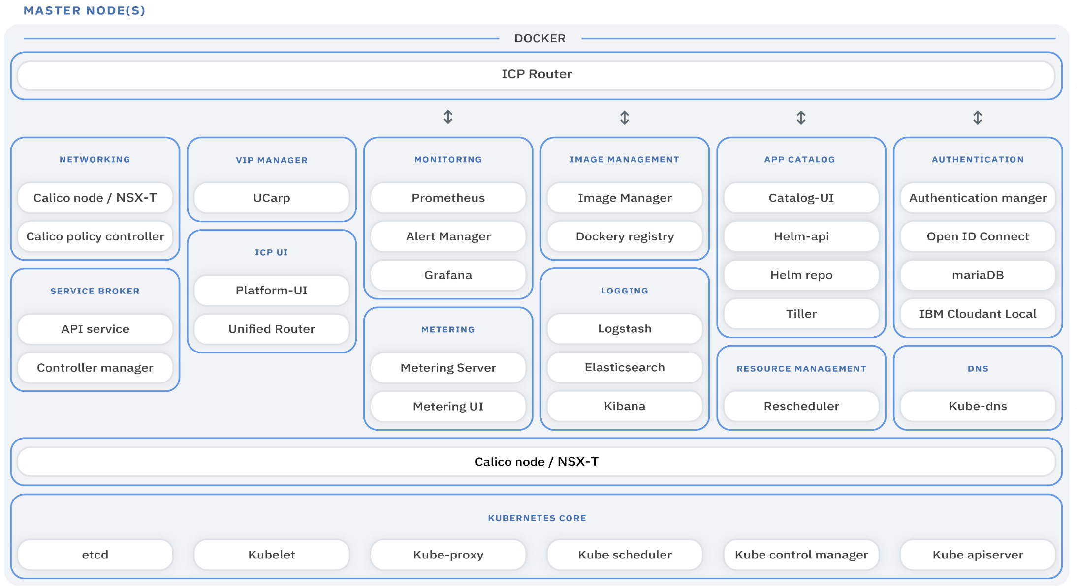
Master Node Provides management services and controls the worker nodes in a cluster
Master nodes host processes that are responsible for resource allocation, state maintenance, scheduling, and monitoring
Multiple master nodes are in a high availability (HA) environment to allow for failover if the leading master host fails
It is possible to load balance across multiple master nodes

Slide 7
etcd Node
An etcd node is an optional node that is used for running the etcd distributed key value store that typically runs on the master nodes
Calico shares etcd with cluster management
Configuring an etcd node in an IBM Cloud Private cluster that has many nodes, such as 100 or more, helps to improve the etcd performance by separating workload from the master node(s)

Slide 8

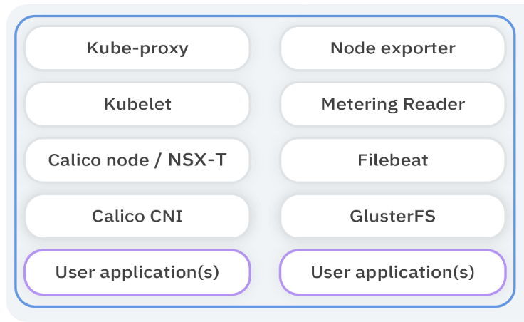
Worker Node Provides a containerized environment for running workload and tasks
Worker nodes can be added at any time to accommodate additional workload
Worker nodes can be drained and removed to scale down the capacity of the cluster
A cluster can contain any number of worker nodes, but a minimum of one worker node is required

Slide 9

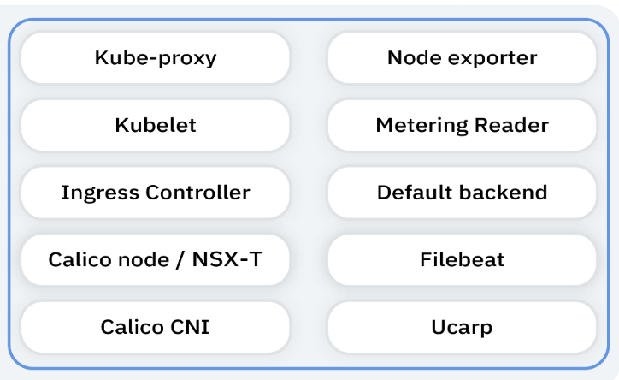
Proxy Node Transmits external request to the services created inside your cluster
Multiple proxy nodes are deployed in a high availability (HA) environment to allow for failover if the leading proxy host fails
While you can use a single node as both master and proxy, it is best to use dedicated proxy nodes to reduce the load on the master node
Configure traffic to use the proxy via the Ingress object

Slide 10

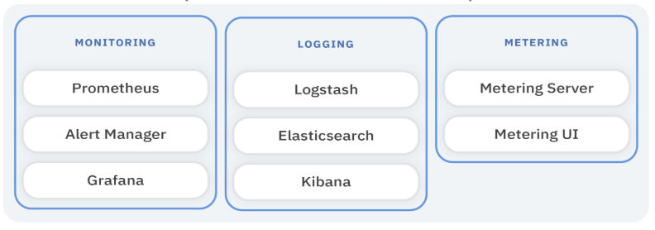
Management Node Optional node that only hosts management services such as monitoring, metering, and logging
By configuring dedicated management nodes, you can prevent the master node from becoming overloaded
You can enable the management node only during IBM Cloud Private installation
Multiple management nodes do not natively provide for high availability

Slide 11

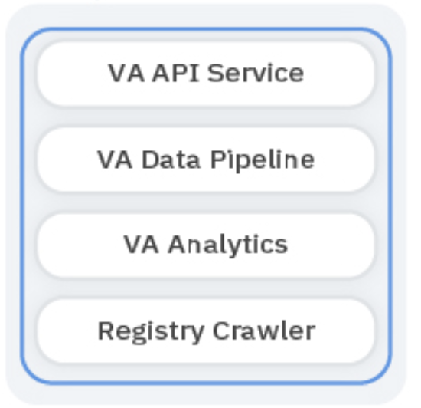
Vulnerability Advisor (VA) Node Optional node that is used for running the Vulnerability Advisor services
VA provides security management for Kubernetes environments
It generates a security status report suggesting fixes and best practices also providing management to restrict non-secure images from running
Can be added post cluster deployment
Can deploy multiple VA nodes to accommodate failover

Slide 12
Component Architecture

Slide 13
IBM Cloud Private Architecture
Components, Interfaces, Services

Slide 14
Kubernetes Core Components These primary components provide the cluster’s control plane and global decisions about the cluster and detecting and responding to cluster events
Etcd: A strong, consistent, and highly-available key value store which Kubernetes uses for persistent storage of all of its API objects and also shares with Calico
Kubelet: The primary “node agent” that runs as a service on each of the cluster nodes
K8s Proxy: The Kubernetes network proxy runs on each node implementing a VIP for each of the services running in K8s (except the externalName service)
K8s Scheduler: A policy-rich, topology-aware, workload-specific function that significantly impacts availability, performance, and capacity of the cluster taking into consideration resource requirements, hardware / software / policy constraints, affinity specifications, data locality, inter-workload interference, etc.

Slide 15
Kubernetes Core Components (continued)
K8s Control Manager: A controller is a control loop that watches the shared state of the cluster through the API Server and makes changes attempting to move the current state towards the desired state with the Control Manager being a daemon that embeds the core control loops shipped with K8s
K8s apiserver: Validates and configures data for the API objects which include pods, services, replication controllers, and others via REST operations providing the frontend to the cluster’s shared state through which all other components interact

Slide 16
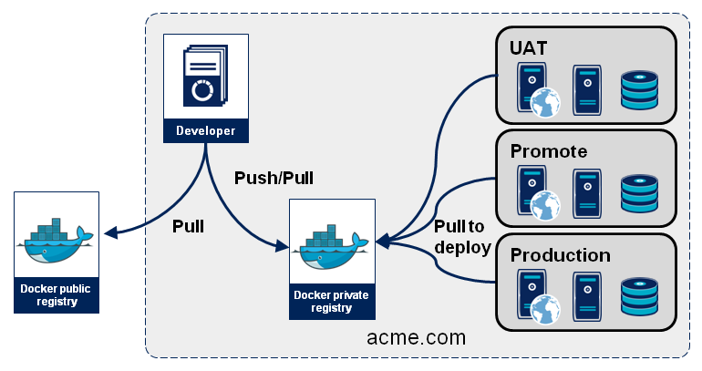
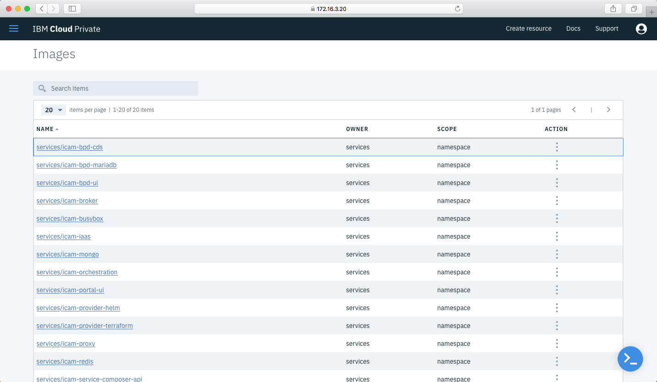
Image Management
Runs as a layer over the Docker registry V2 API
Provider of management functions and authorization for image repositories that the Docker registry stores
Similar to the Docker Hub but with restrictions

Slide 17
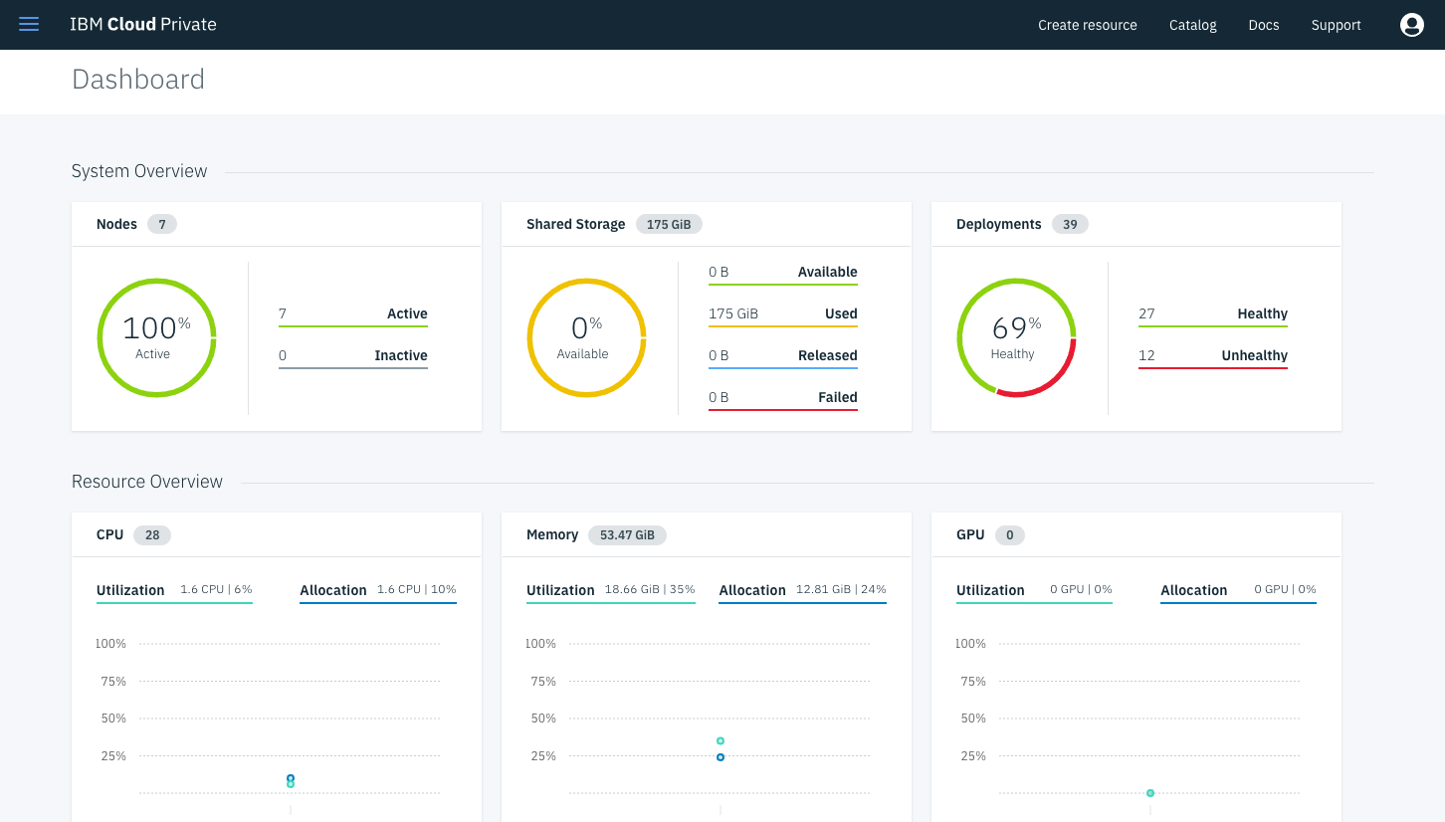
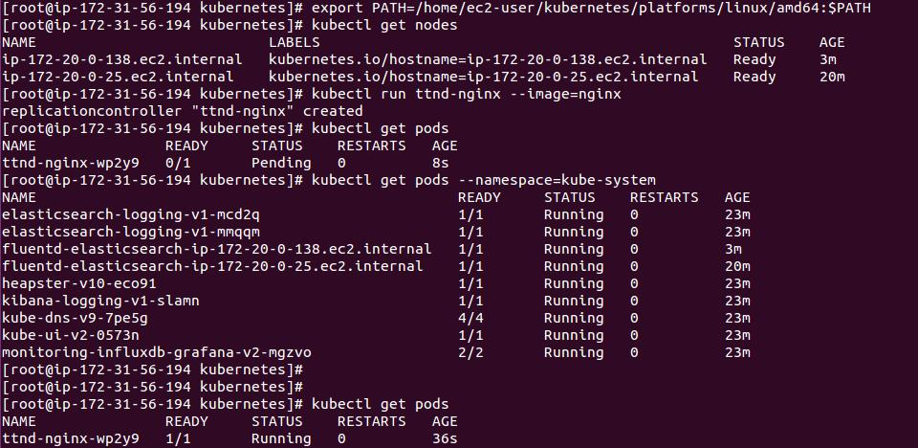
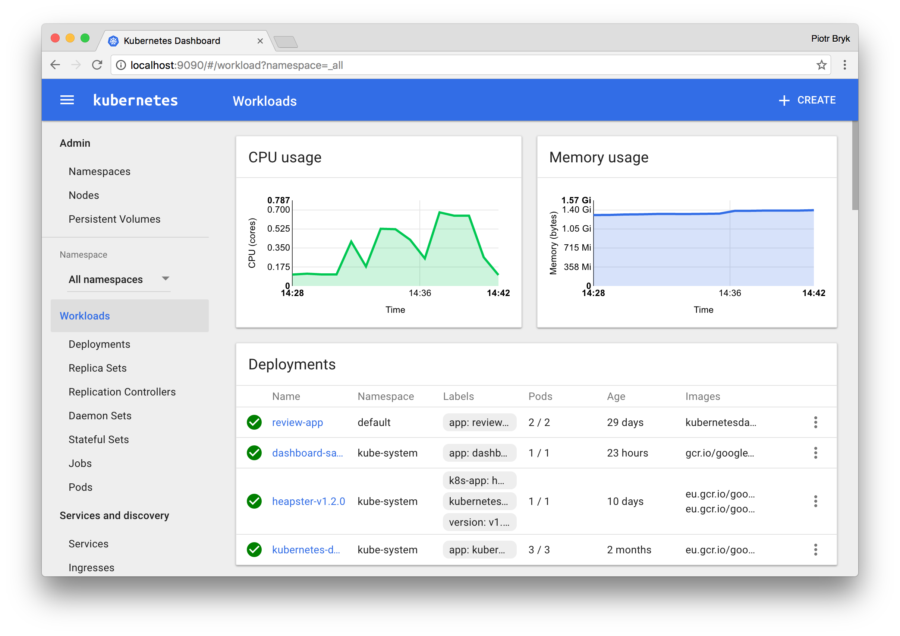
User Interfaces
Several convenient was to access the private cloud
Cluster Management Console: Manage, monitor, and troubleshoot your applications and cluster from a single, centralized, and secure management console
CLIs: Manage any / all aspects of your clusters, Kubernetes, charts, deployments etc. using your favorite command line tools such as the ICP CLI, K8s CLI, Helm and Calico interfaces / APIs
K8s Web UI: You can deploy and use the traditional K8s UI
17
IBM Cloud / © 2018 IBM Corporation

Slide 18
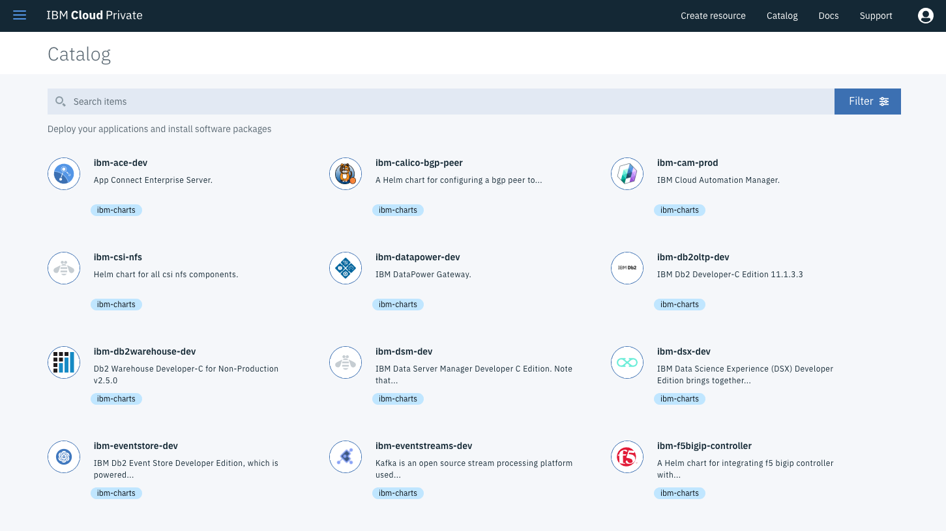
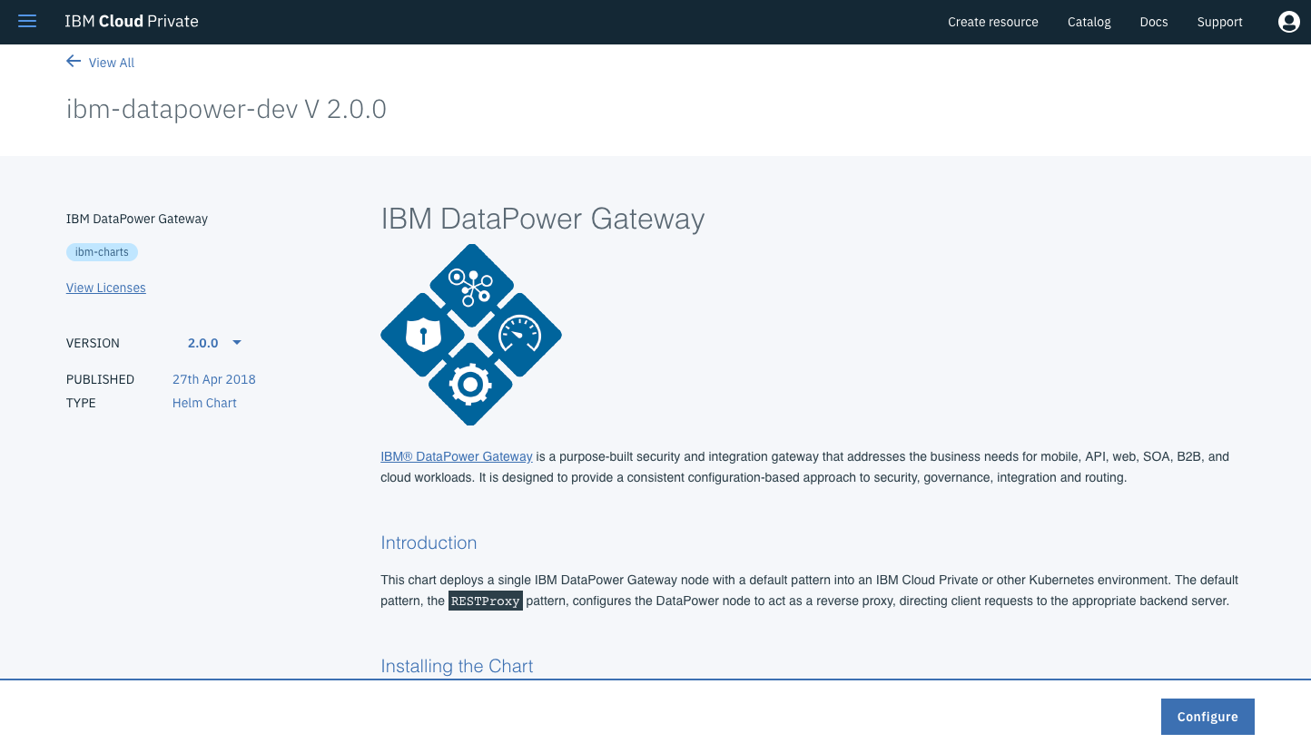
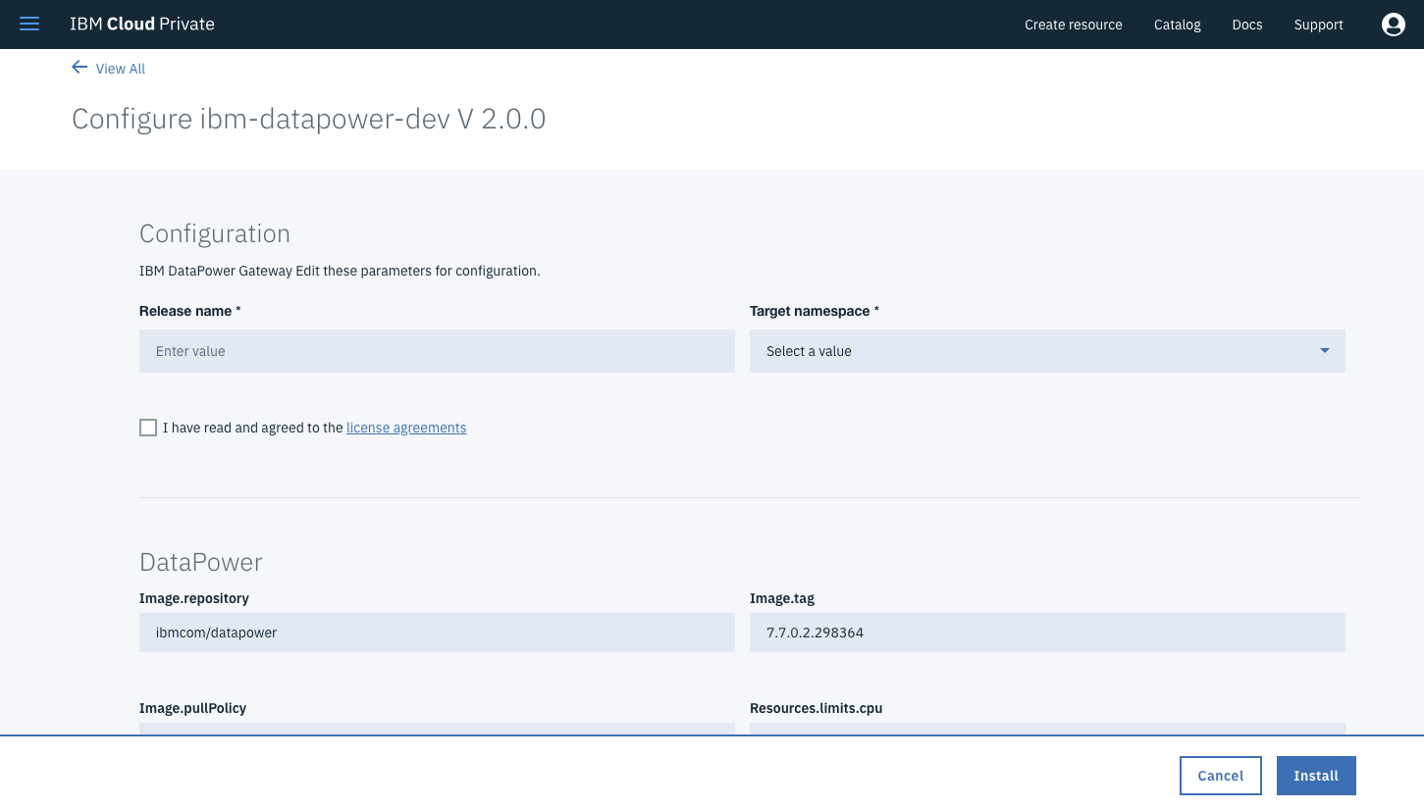
Catalog
The catalog provides a centralized location from which you can browse, and install applications and software packages in your cluster
Helm: A tool for managing Kubernetes packages of pre-configured Kubernetes resources called “charts”
Helm Repository: A Helm chart repository is a location where packaged charts can be stored and shared
Tiller: Runs inside of the cluster, and manages releases (installations) of your charts
IBM Cloud / © 2018 IBM Corporation

Slide 19
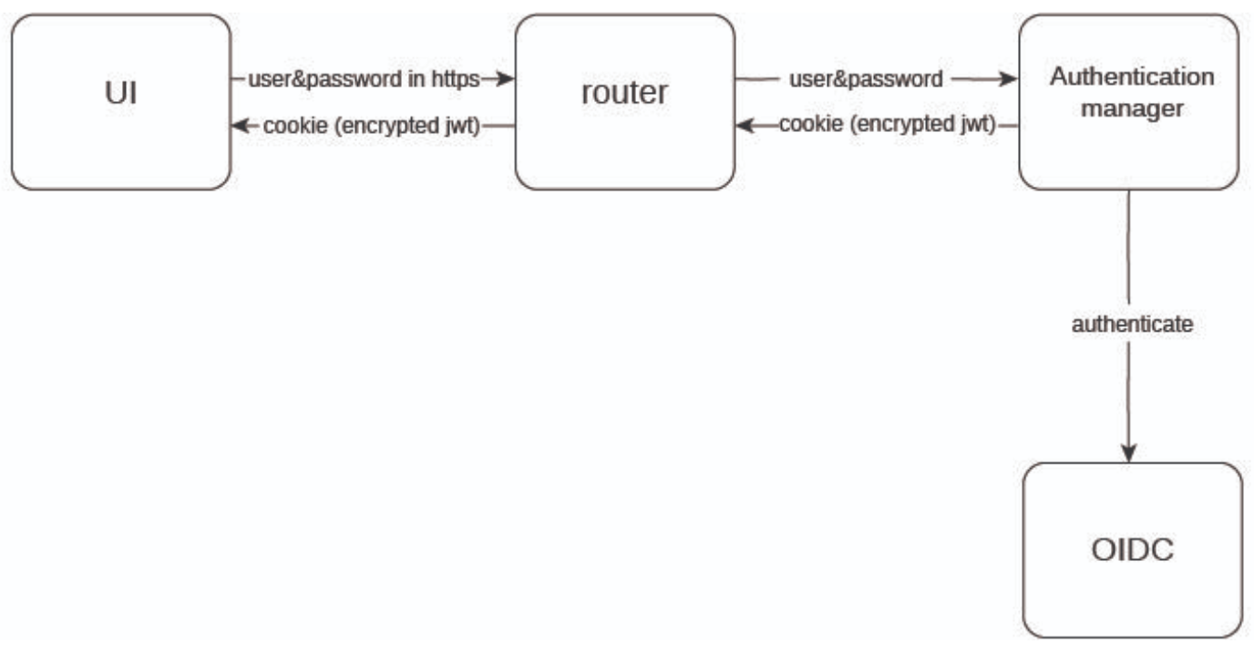
Authentication Manager Facilitates the transfer of credentials between the cluster management console and the OpenID Connect provider
The authentication manager accepts user credentials from the management console and forwards the credentials to the backend OIDC provider
The OIDC provider validates the user credentials against the enterprise directory. It then returns an authentication cookie (auth-cookie) with the content of a JSON web token (JWT) to the Authentication manager
This authentication cookie is then sent back to the management console. The cookie is refreshed during the session. It is valid for 12 hours after you sign out of the management console or close your browser.
Notes:
For all subsequent authentication requests made from the management console, the front-end NGINX server decodes the available authentication cookie in the request and validates the request by calling the Authentication manager.

Slide 20
DNS kube-dns / Cluster DNS
K8s DNS schedules a DNS pod and service on the cluster, and configures the kubelets to tell individual containers to use the DNS service’s IP to resolve DNS names. Every service defined in the cluster (including the DNS server itself) is assigned a DNS name
By default, a client pod’s DNS search list will include the pod’s own namespace and the cluster’s default domain

Slide 21
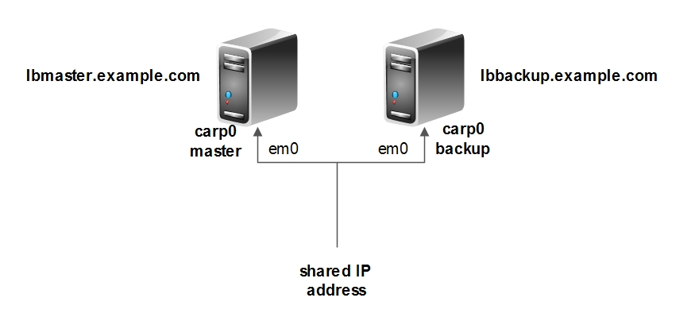
VIP and UCarp kube-dns / Cluster DNS
UCarp allows a couple of hosts to share common virtual IP (or floating IP) addresses in order to provide automatic failover

Slide 22
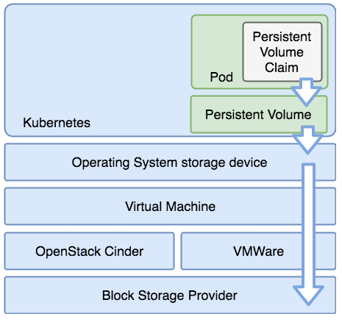
Persistent Storage
Persistent Volume is a storage resource within the cluster. PVs have a lifecycle independent of any individual pod that uses it. This API object encapsulates the details of the storage implementation or cloud-provider-specific storage system.
A Persistent Volume Claim is a storage request, or claim, made by the developer. Claims request specific sizes of storage, as well as other aspects such as access modes.
A StorageClass describes an offering of storage and allow for the dynamically provisioning of PVs and PVCs based upon these controlled definitions.

Slide 23
IBM Cloud Private Storage Providers
Kubernetes and IBM Cloud Private offer many options for managing persistent storage within the cluster. ICP features the following:
GlusterFS enterprise grade of storage to K8s pods offering ease of configuration, scaling, encryption support, replication, striping and dynamic provisioning.
vSphere Cloud Provider (vSphereVolume Plugin) gives access to enterprise grade storage (vSAN, VMFS, Vvol) that is native to and already supported by the VMware infrastructure.
IBM Spectrum Scale for solutions not hosted in VMware provides direct access to IBM block storage via dynamic provisioning.
NFS provides a versatile and easy to use method of getting persistent storage to pods that is already available in most customer environments.
HostPath is ideal for testing persistence in non-production environments.
Ceph is an industry proven option that can provide several storage options along with persistent volumes for Kubernetes
23
IBM Cloud / © 2018 IBM Corporation

Slide 24
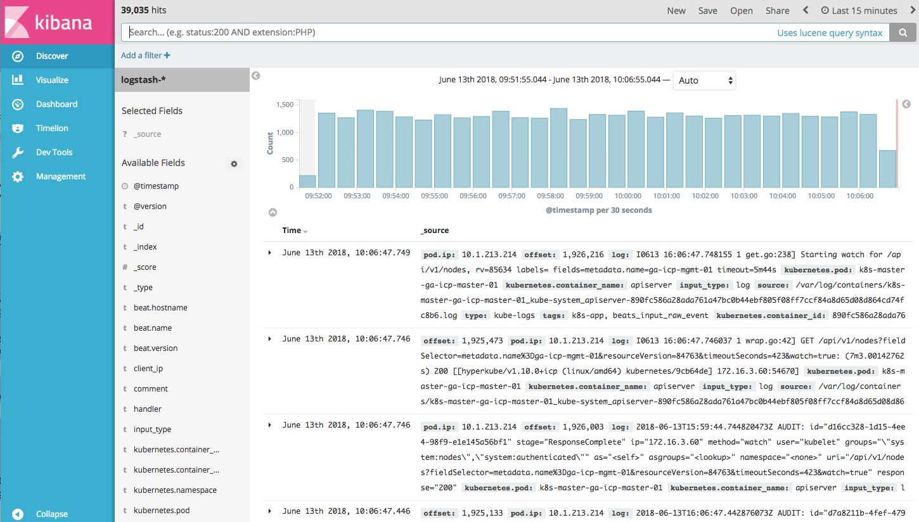
Logging ELK / Elastic Stack
Filebeat: A log data shipper for local files. Filebeat monitors the log directories or specific log files, tails the files, and forwards them either to Elasticsearch and/or Logstash for indexing
Elasticsearch: An open source full-text search engine based on Lucene. It provides HTTP web interface and schema-free JSON documents
Logstash: A open source tool for collecting, parsing, and storing logs for future use.
Heapster: The Kubernetes network proxy runs on each node
Kibana: An open source data visualization plugin for Elasticsearch. Users can create bar, line and scatter plots, or pie charts and maps on top of large volumes of data
Notes:
The easiest and most embraced logging method for containerized applications is to write to standard out and standard error

Slide 25
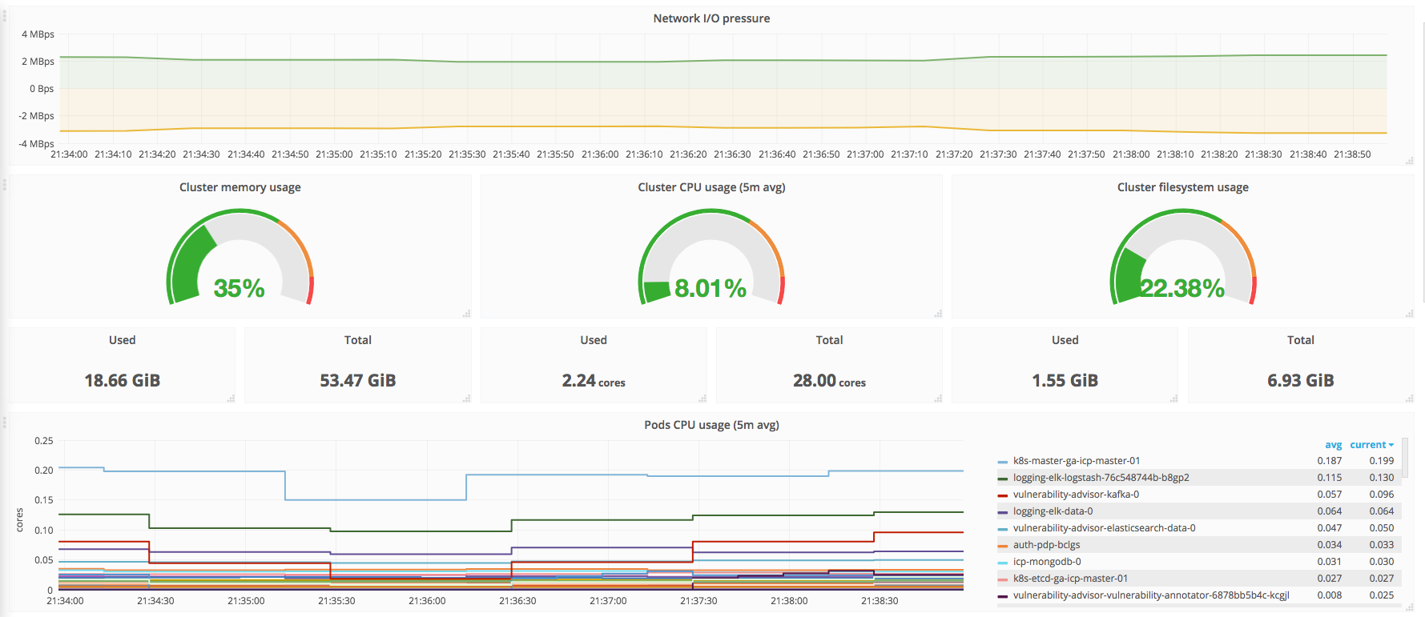
Monitoring Prometheus and Grafana
Prometheus: An open-source systems monitoring and alerting toolkit originally built at SoundCloud. Since its inception in 2012, many companies and organizations have adopted Prometheus, and the project has a very active developer and user community. It is now a standalone open source project and maintained independently of any company.
Grafana: An open-source, general purpose dashboard and graph composer, which runs as a web application.

Slide 26

Network Overlay Calico
A new approach to virtual networking and network security for containers, VMs, and bare metal services, that provides a rich set of security enforcement capabilities running on top of a highly scalable and efficient virtual network
The Calico/node Docker container runs on the Kubernetes master and each Kubernetes node in the cluster
The calico-cni plug-in integrates directly with the Kubernetes kubelet process on each node to discover which pods have been created, and adds them to Calico networking
The calico/kube-policy-controller container runs as a pod on top of Kubernetes and implements the NetworkPolicy API
Notes:
This slide will be replaced

Slide 27
Ingress Resources Ingress, Ingress Controller, Proxy
Ingress: Typically, services and pods have IPs only routable by the cluster network. All traffic that ends up at an edge router is either dropped or forwarded elsewhere.
An Ingress is a collection of rules that allow inbound connections to reach the cluster services
It can be configured to give services externally-reachable URLs, load balance traffic, terminate SSL, offer name based virtual hosting etc.
Users request ingress by POSTing the Ingress resource to the API server
Ingress Controller: Responsible for fulfilling the Ingress, usually with a load balancer, though it may also configure your edge router or additional frontends to help handle the traffic in an HA manner
Notes:
This slide will be replace

Slide 28
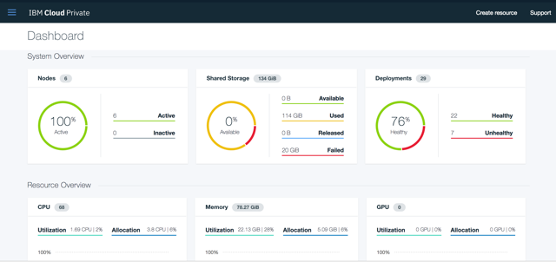
Try IBM Cloud Private today!
Guided and Proof of Technology demos
Free Community Edition!
http://ibm.biz/ICP-DTE
28
28
IBM Cloud / © 2018 IBM Corporation

Slide 29
29

